Slide 1
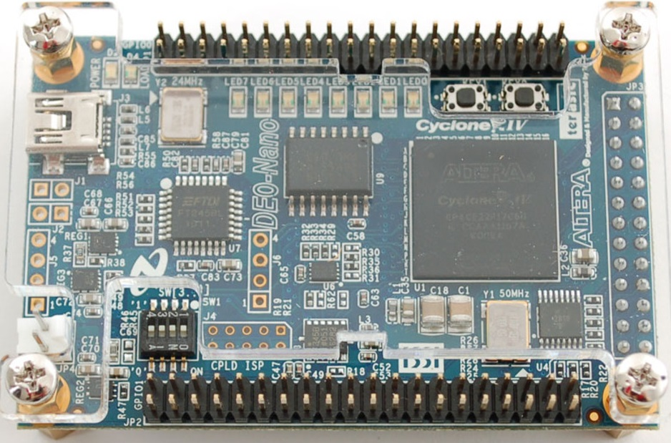
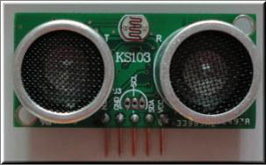
DE0-Nano Board & KS103 Ultrasound Module

Slide 2
Why do we need the Nano
Board?

Slide 3
Why do we need the Nano
Board?
We use the DE0-Nano Board to provide an interface for the Raspberry Pi 3 to control the car

Slide 4
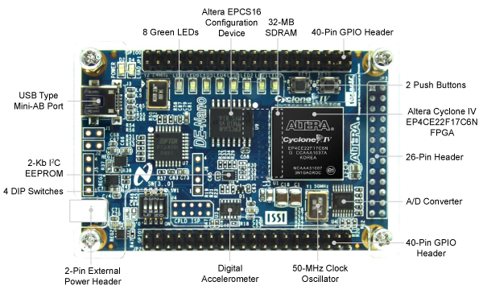
Features of the Board
Memory Devices
32-MB SDRAM
2Kb I2C EEPROM
General user input/output
8 green LEDs
2 debounced pushbuttons
4-position DIP switches
Expansion header
Two 40-pin Headers (GPIOs) provide 72 I/O pins, 5V power pins, two 3.3V power pins and four ground pins
Clock system
On-board 50MHz clock oscillator
Power Supply
USB Type mini-AB port (5V)
DC 5V pin for each GPIO header (2 DC 5V pins)
2-pin external power header (3.6-5.7V)

Slide 5
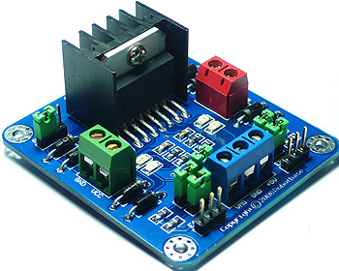
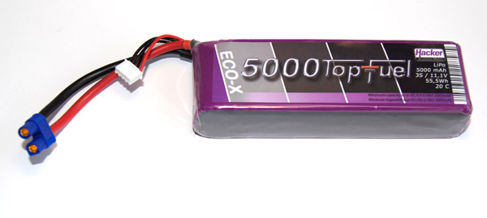
Our Nano board works at 5V, so we use an H-bridge to convert from the battery coming current to 5V.

Slide 6
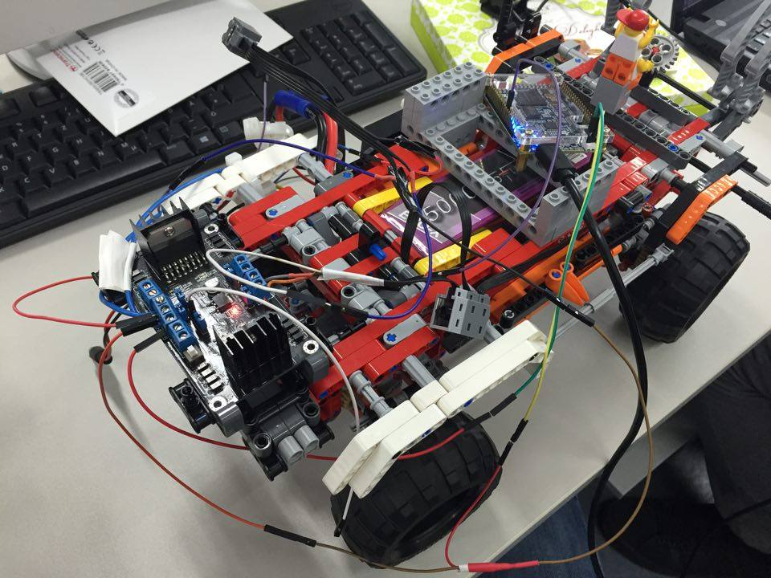
Connection between the H-Bridge and Nano Board

Slide 7
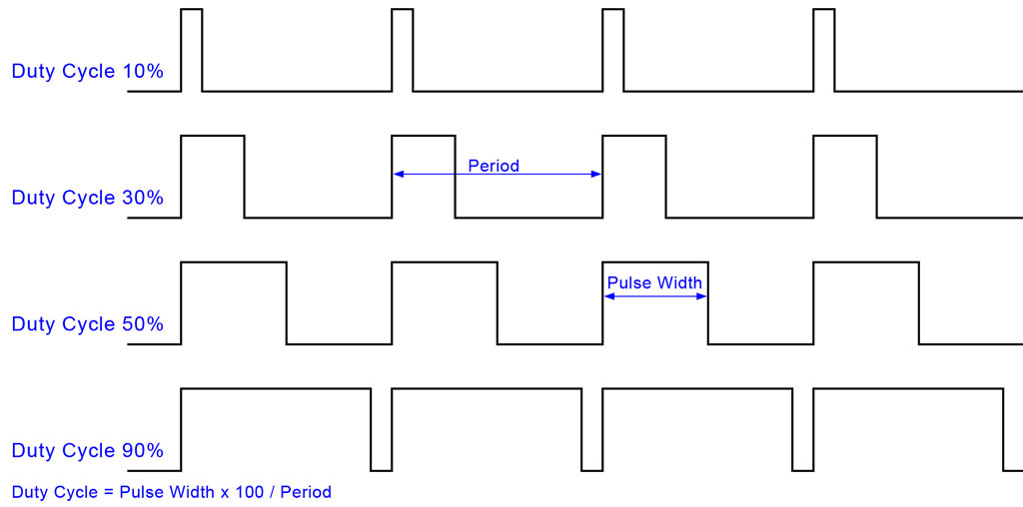
PWM(Pulse-width Modulation)
PWM is a modulation technique used to encode a message into a pulsing signal
The width of the pulse is modulated depending on the requirement

Slide 8
Why do we use the PWM?
The voltage can be changed to control the speed of our motor

Slide 9
Why do we use the PWM?
Analog vs Digital Voltage Control
The voltage can be changed to control the speed of our motor

Slide 10
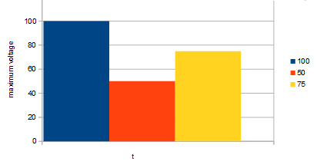
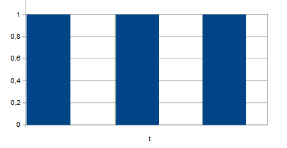
Why do we use the PWM?
Analog vs Digital Voltage Control
The voltage can be changed to control the speed of our motor

Slide 11
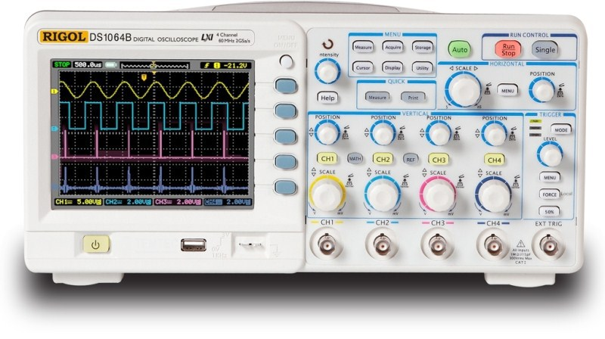
Oscilloscope
We use the oscilloscope to verify the duty cycle

Slide 12
Oscilloscope
We use the oscilloscope to verify the duty cycle
Link to Lego Car

Slide 13
KS103 Ultrasound Module
We use this device to measure the distance between our car and the obstacle

Slide 14
KS103 Ultrasound Module
We use this device to measure the distance between our car and the obstacle
Pins
VCC: power pin
SDA/TX: data pin
SCL/RX: clock pin
GND: power ground pin
Mode: selects the communication mode

Slide 15
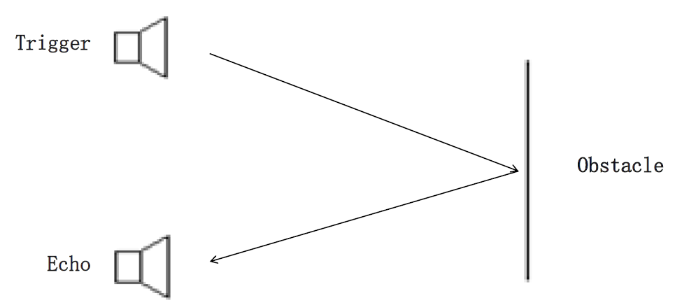
How It Works?
The trigger sends chirps and then the device calculates the distance by using this formula: (340(m/s) x ∆t(s)) / 2)

Slide 16
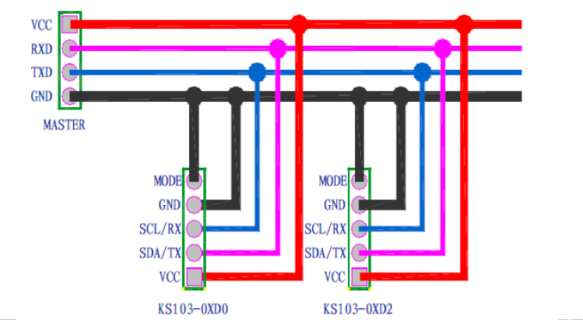
Connection of Three Modules
Our task was to connect three modules with each other

